Slide 1
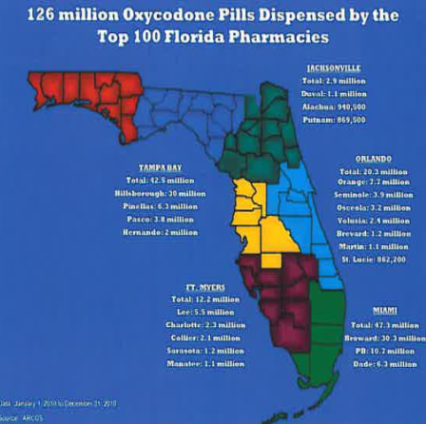
Oxycodone
should not be prescribed
for moderate pain because it
leads to addiction.

Slide 2
What is oxycodone?
Opioid Analgesic
Brand names: Dazidox, OxyContin, Oxyfast, OxyIR, Percolone, Roxicodone, Roxicodone Intensol, M-Oxy, ETH-Oxydose, and Endocodone
Comibnation brand names: Combunox, Endocet, Endodan, Lynox, Magnacet, Narvox, Percocet, Percodan, Perloxx, Primlev, Roxicet , Roxiprin, Taxadone, Tylox, and Xolox (all containing either aspirin, acetaminophen, or ibuprofen in combination with oxycodone)
Street names: Blues, Cotton, Hillbilly Heroin, Kicker, Ocs, Ox, Os, Oxy, 40, and 80.

Slide 3
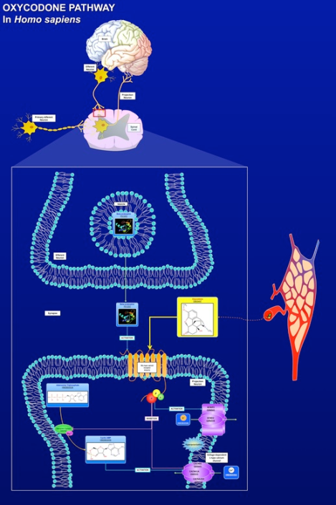
How it works:
Oxycodone exerts its analgesic by acting on the opioid receptor of sensory neurons. Binding to the opioid receptor activates associated proteins. These subsequently act to inhibit adenylate cyclase, reducing the level of intracellular cAMP. It also activates potassium channels and inactivates calcium channels causing the neuron to hyperpolarize. The end result is decreased nerve conduction and reduced neurotransmitter release, which blocks the perception of pain signals.
http://www.youtube.com/watch?v=paAzzwZi3vk
Notes:
http://www.youtube.com/watch?v=paAzzwZi3vk

Slide 4
Addiction
What is addiction? http://www.hbo.com/addiction/thefilm/supplemental/6212_what_is_addiction.html
The rate of lifetime nonmedical users of oxycodone was 13.7 million in 2003.
90% of patients at a detox center in Florida called New Beginnings are admitted for oxycodone addiction, and the patients ages range in ages from 14 to 70 years old.

Slide 5
Why might I be prescribed oxycodone?
Getting your wisdom teeth out
Going through chemotherapy or experiencing sudden pain from cancer
Osteoarthritis
Chronic back pain
Epididymitis (testicular infection)
Migraine
Ruptured ear drum
Many doctors will prescribe oxycodone to patients in order to receive part of the money the patient will get for selling it.

Slide 6
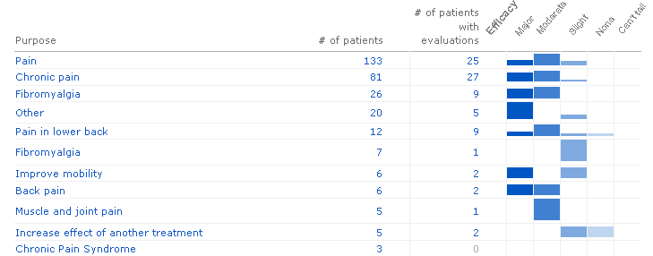
Why use oxycodone?

Slide 7
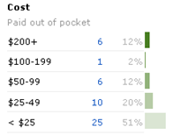
Why use oxycodone?
Most of the respondents to this survey pay less than $25 for their oxycodone. This is very economically friendly, especially for patients who may not be able to work due to their debilitating condition.

Slide 8
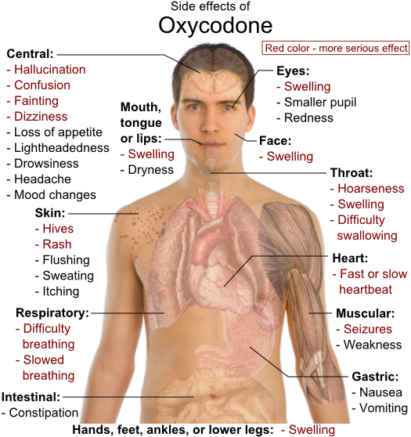
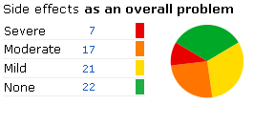
Some problems…

Slide 9
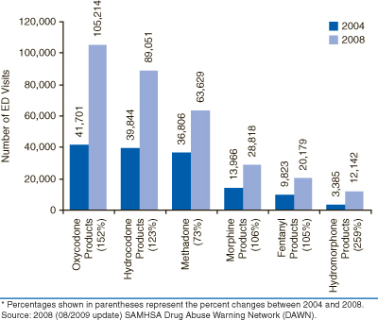

Slide 10
The problem with oxycodone
Addiction…
Prescription drugs kill six Floridians per day.
The death rate from oxycodone increased 265% from 2003 to 2009, the CDC found.
By 2009, the number of deaths involving prescription drugs was four times the deaths involving street drugs, the CDC said in a July report.
Cost to society: Oxycodone abuse and addiction cost tax-paying Americans over $484 billion annually. This figure includes healthcare costs, traffic accidents, lost job wages and the associated criminal justice systems costs.

Slide 11
The solution
E-FORCSE: Electronic-Florida Online Reporting of Controlled Substances Evaluation – went active October 17th
My solution suggestion of only prescribing it for moderate pain would probably not be as effective as the database, but I thought the database was not an option since in August, the Florida Governor said it would be a threat to privacy.
Millions of addicts will be going through withdrawal at the same time. Do we have the kinds of resources to accommodate them?

Slide 12
Bibliography
http://pathman.smpdb.ca/pathways/SMP00409/pathway?reset=true&highlight%5bDB00497%5d=true
Nih.gov
Forum.opiophile.org
http://www.alligator.org/news/local/article_4e3848d8-f945-11e0-bcda-001cc4c002e0.html
http://www.usatoday.com/news/nation/story/2011-10-13/pill-mill-drug-trafficking/50896242/1
http://www.oxycodoneaddictionhelp.com/oxycodone-addiction-statistics
http://www.newbeginningsdetox.com/articles-oxycodone.shtml

